Slide 1
Validation of Stochastic Lagrangian Particle Dispersion Models Using Inter-Model Variability and Sensitivity Analysis: Case study on April 2025 sand-dust transport and hypothetical nuclear releases
Chow Yin Hei R4 summer intern, The Hong Kong Observatory
Supervisors: Kwan Kam Lun SEO(R)41, Kong Yu Chau AgSSO(R)4

Slide 2
Agenda
Background & motivation
Methodology
Case study 1: April 11 sand-dust storm over China
Similarity among model predictions
Validation against real measurements
Case study 2: Hypothetical nuclear leak
Conclusion

Slide 3
Background & motivation
Flexpart is a Lagrangian particle dispersion model for simulating the turbulent transport of substance in the atmosphere over long distances. It performs importance sampling of the underlying distribution of dispersed species by introducing particles as mesoscale entities that follow the turbulent flow.
Given initial condition of the release, Flexpart calculate particle trajectories according input meteorological fields. The air concentration of the released species is then calculated by interpolating the particles. Loss processes like dry deposition, cloud scavenging, and radioactive decay are modelled by adjusting the weight of each particle.
Flexpart version 11 came out in October 2024. Substantial changes are made since version 9, in terms of the coordinate system used, below cloud scavenging schemes, interpolation scheme, and parallelization. Version 9 is currently used by HKO in preparing for nuclear emergencies, thus the validation of newer versions is of interest for potential adoption.

Slide 4
Methodology
Case | Real-world | Hypothetical
Release time (UTC) | 20250410 15:00 | 20250511 00:00
Release duration | 14 h | 3 h
Release location | Dust hotspot identified in Gobi desert | Hanbit nuclear power plant (point source)
Release height | 0 to 600 m | 0 to 50 m
Species | Sand-dust | Cs-137
Mass emitted | 1.1 × 10¹¹ kg | 5 kg
Particle number | 1M | 0.1M
Meteorological forcing fields | GFS forecast data every 12 h | GFS forecast data at release time
Simulation time | 10 days | 10 days
Two cases are studied for version 9, 10 and 11
(Real-world.) April 11 2025 sand-dust storm event initializing at Gobi desert and affecting Northern and Southern China.
(Hypothetical.) A nuclear release scenario at Hanbit nuclear power plant May 11, 2025. The hypothetical dispersion of Cs-137 radioactive species is modelled to test consistency among the versions.

Slide 5
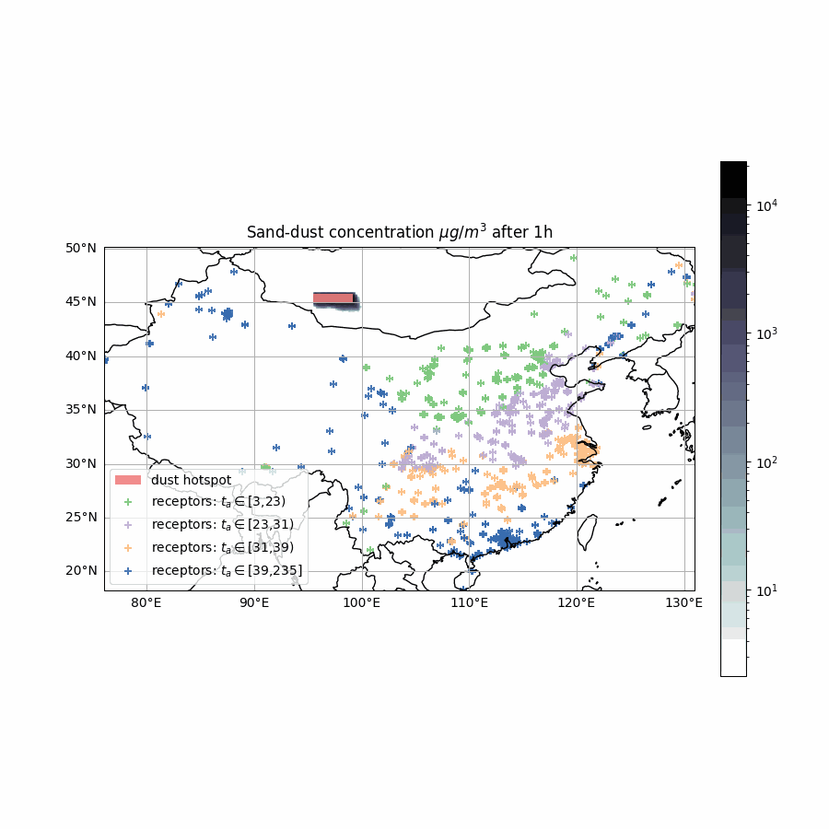
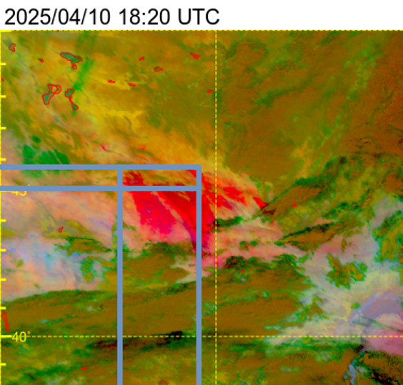
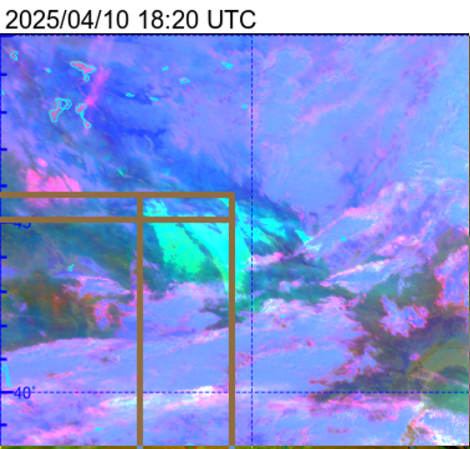
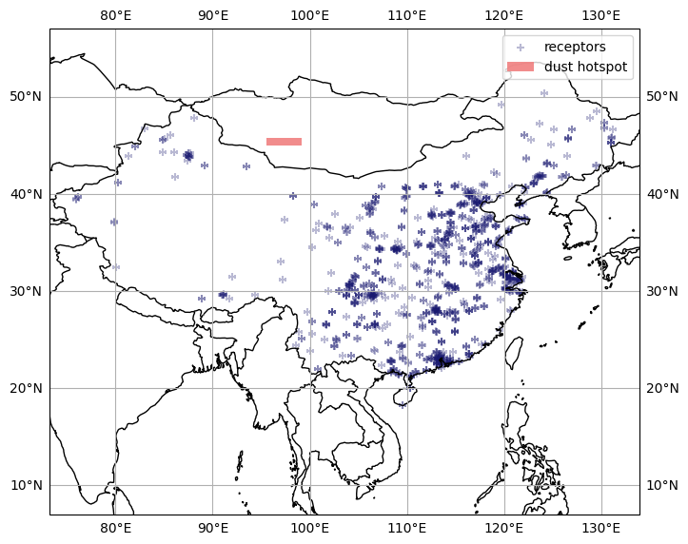
Case 1. April 11 2025 sand-dust storm originating from Gobi desert
(Initial condition.) The range of latitude, longitude and time of sand-dust production is determined by satellite images. A heuristic release profile consisting of a uniform initial distribution is used.
(Ground-truth.) Model predictions are benchmarked against of openly available PM10 time-series data provided by China National Environmental Monitoring Centre (CNEMC).
After data cleaning, hourly PM10 time-series at 1046 locations remains. Sampling locations cover the affected area.

Slide 6
Comparison in absence of ground-truth
Notes:
What can be done in absence of ground-truth, which is often the case without large scale dispersion events

Slide 7
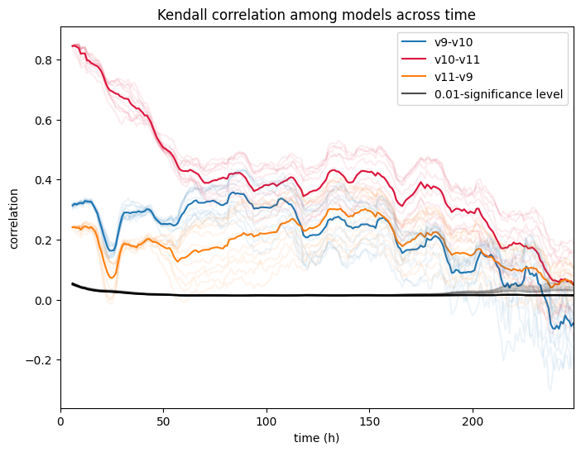
Correlation among model predictions
Kendall correlation is measured pairwise for the three models. To avoid overestimation, the support of each measurement is the set of grid points on which at least one of the pair gives non-zero concentration
Version 10 and 11 maintains the highest correlation across the 10-day simulation period. This aligns with the more significant changes in version 10 update.

Slide 8
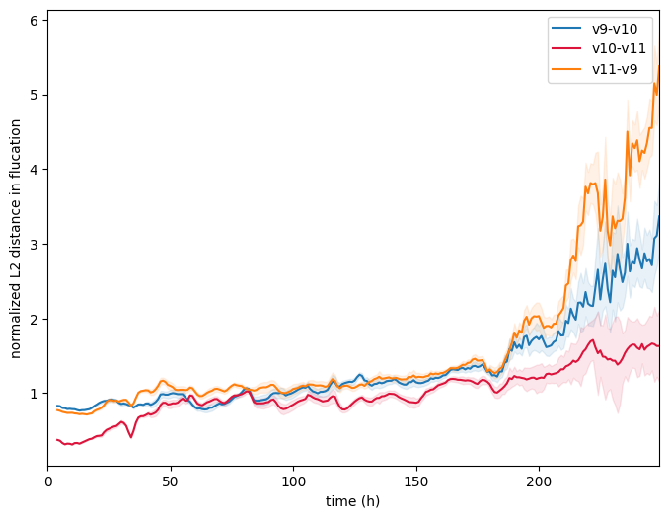
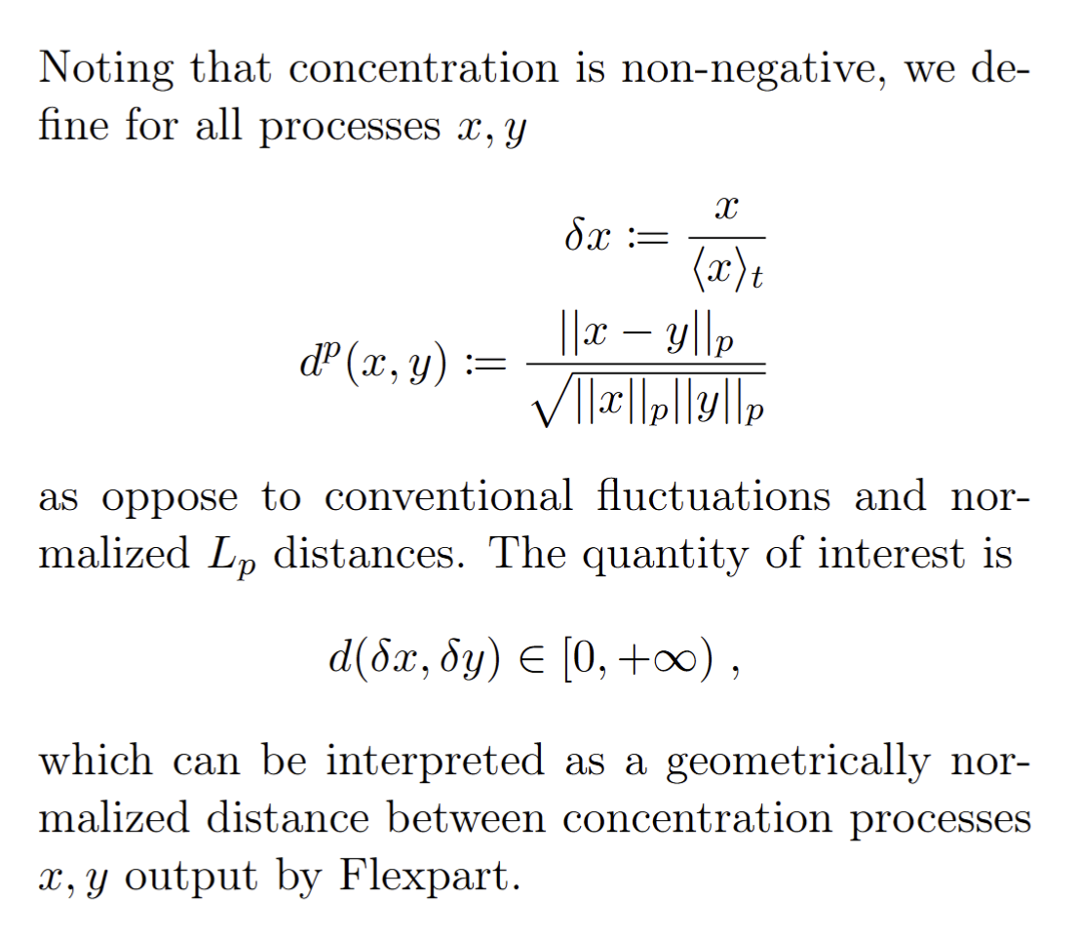
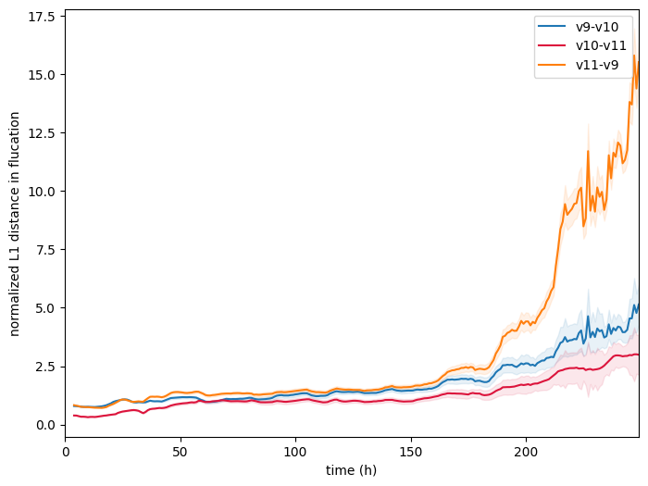
Distance in fluctuation
Notes:
Version 9 is the odd one out, but is it exceptionally better or worse.

Slide 9
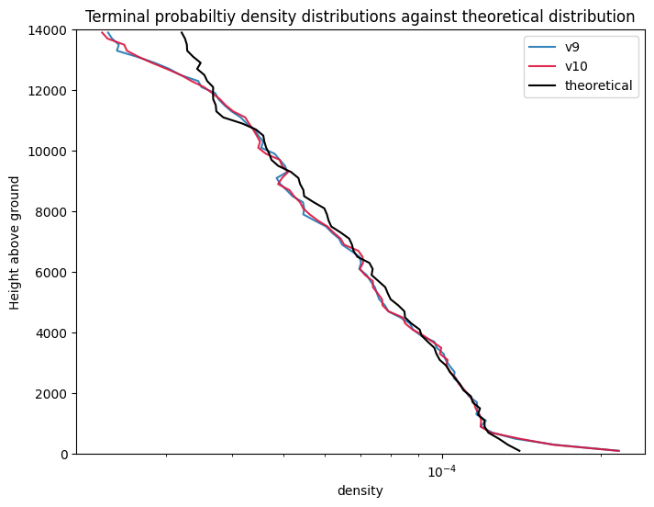
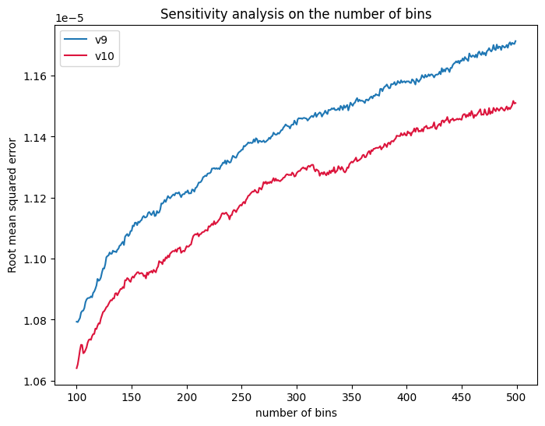
Validation of turbulent mixing over the model domain – well-mixed criterion
In current operations at HKO, Flexpart uses a computationally cheaper Gaussian turbulence scheme, which doesn’t enforce well-mixed criterion a priori.
This test is to validate whether the vertical turbulent transport generated is still physically realistic over the same model domain used for modelling the sand-dust storm event.
Well-mixed criterion states that a species of passive particle uniformly distributed within a turbulent flow in both position and velocity will remain that way in the absence of sources and sinks. It presents a challenge to particle dispersion models in general.
Air tracers are distributed according to the air density over the entire model domain (The GFS data used spans from ground to at least 15 km). The terminal distribution is then compared to the air density at that time.
Future direction: Reanalysis data should be used

Slide 10
Performance metric: Arrival time

Slide 11
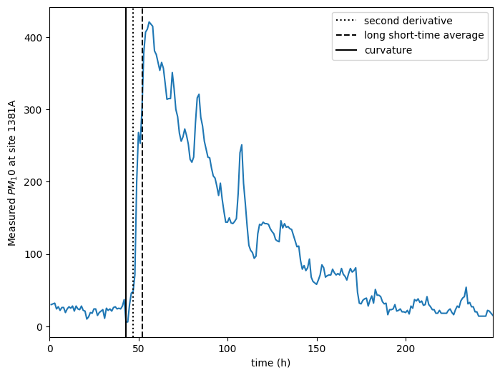
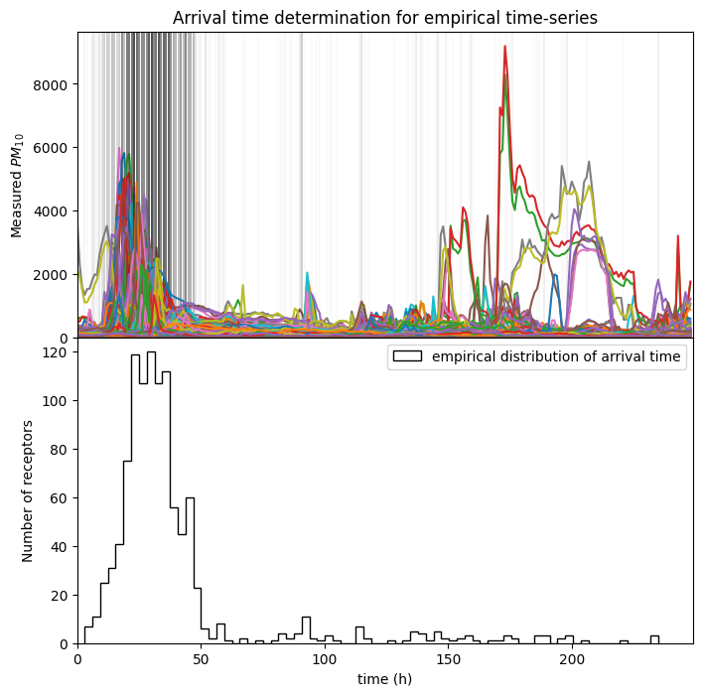
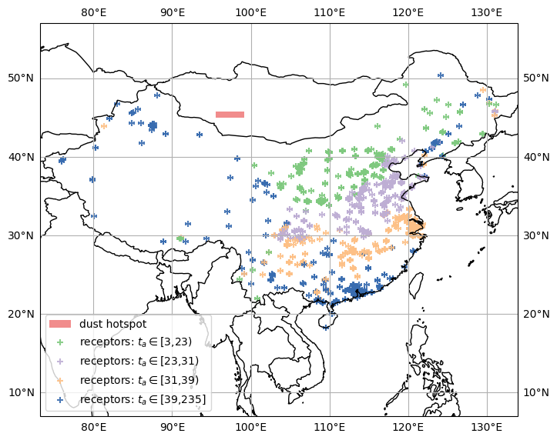
Distribution and visualization of arrival time testing set
Three schemes for determining arrival time is considered, all based on a quantile q of the time-series’: curvature, long short-time average, or second derivative

Slide 12
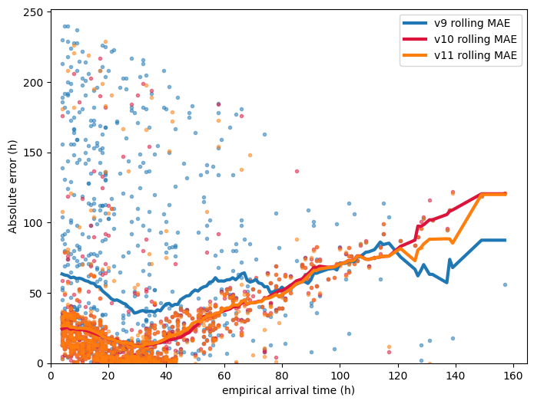
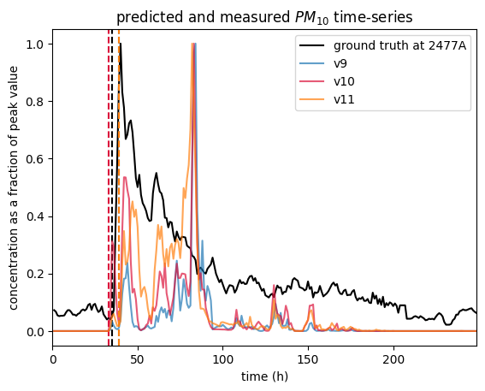
Determination of cutoff and the performance (MAE) sensitivity on it
The performance metric (arrival time) is considered ill-defined if there’re no obvious peak observed in the measured PM10 time-series
Receptors are therefore ranked by the variance on the arrival time determined over different choices of model parameter q.
Top 20 receptors are considered to have ill-defined arrival time and is not used in evaluating the model performance
Marginal case at cutoff. Location: 111.6217, 26.2081
Notes:
When the peak gets less obvious, version 9 performance suffers more

Slide 13
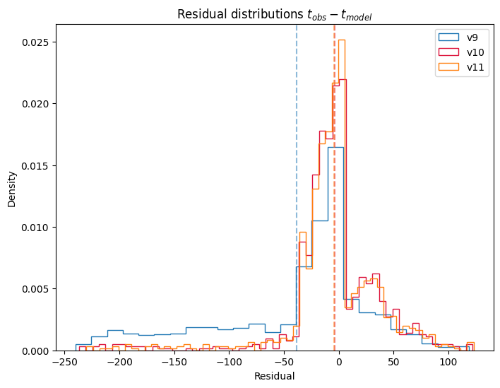
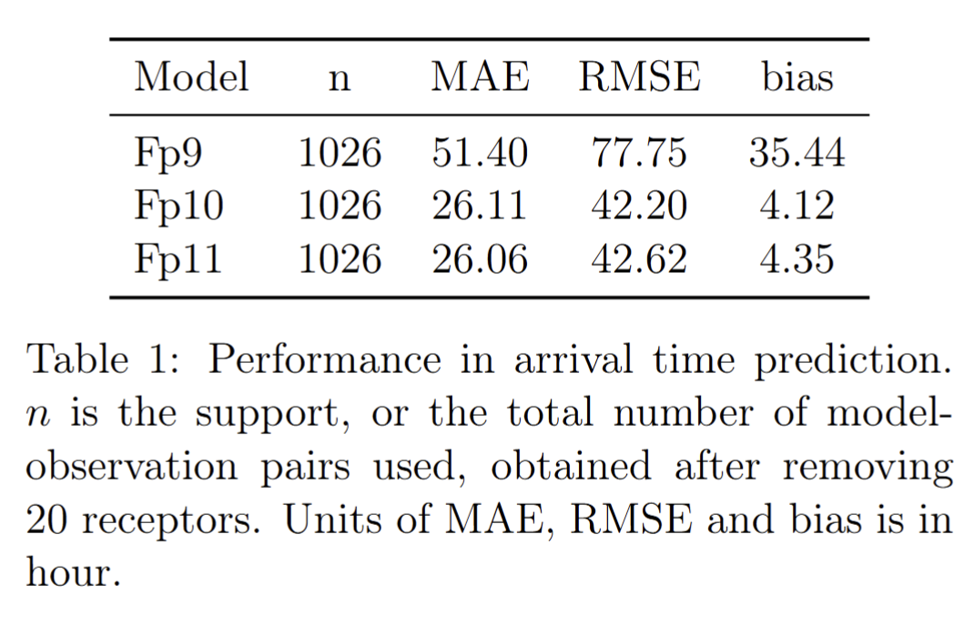
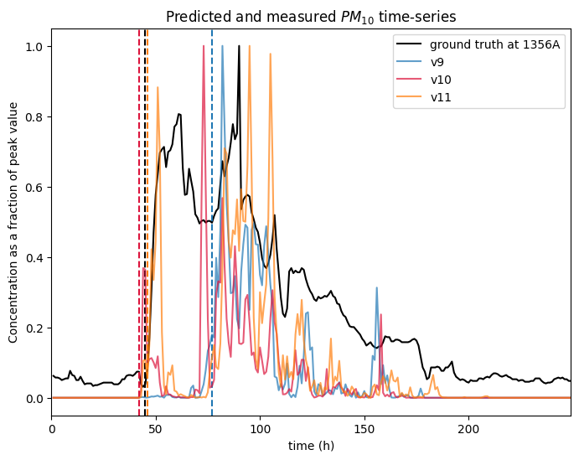
Performance among models
Hong Kong:
Arrival time for Hong Kong is 43-45 h after start of release
Notes:
Arrival time for Hong Kong is 43-45 h after start of release

Slide 14
Performance metric: Correlations with ground-truth

Slide 15
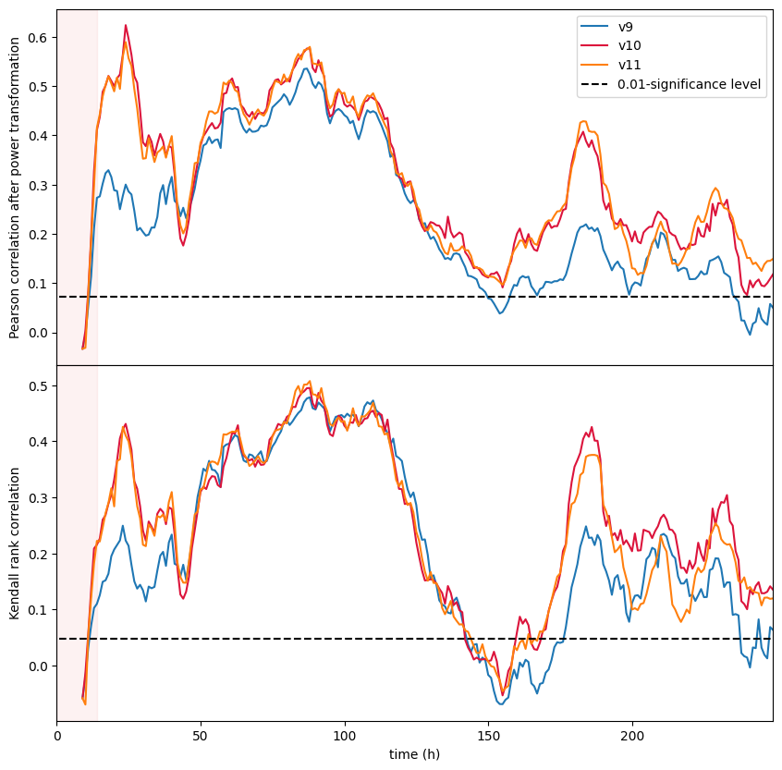
Correlations with ground-truth across simulation time

Slide 16
Location-dependence of Pearson correlations
Mean: 0.16 0.24 0.24 Median: 0.07 0.22 0.21
Notes:
Mean: 0.16 0.24 0.24 Median: 0.07 0.22 0.21

Slide 17
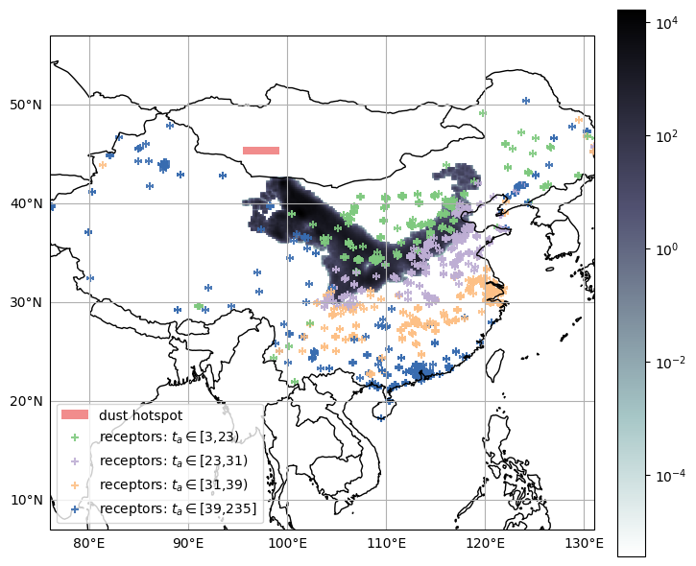
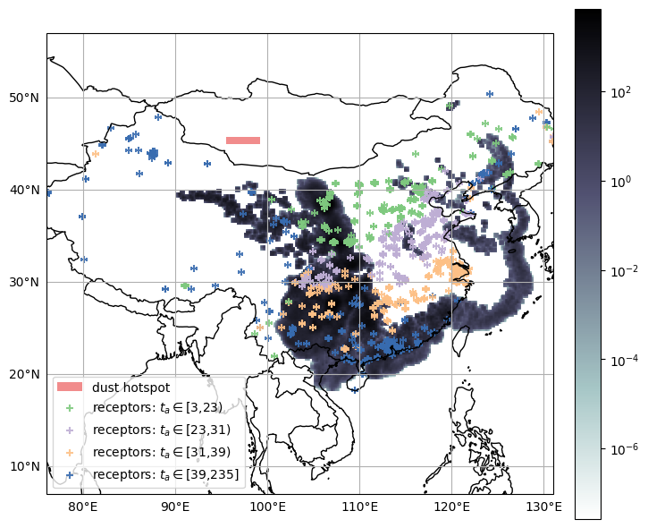
(For reference)
24 h 48 h
Unit is in μg/m³
Notes:
Can skip

Slide 18
Performance metric: Estimation of peak PM10 value

Slide 19
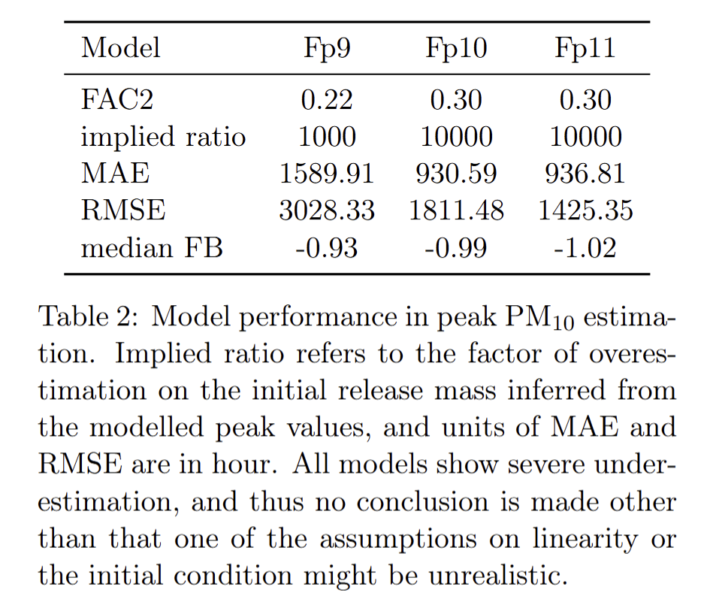
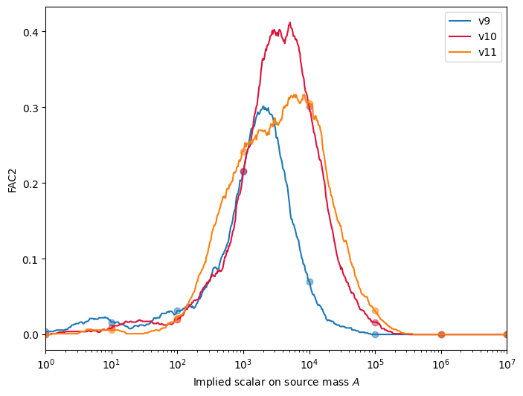
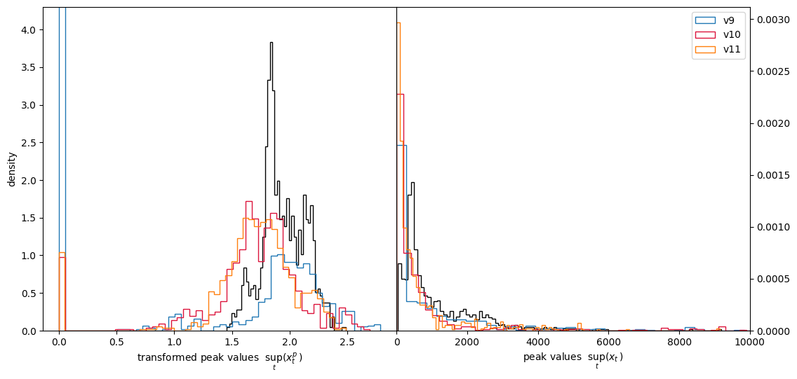
Adjustments on source mass
Assume that peak values prediction, or concentration output of Flexpart in general, is linear in initial released mass.
Tune the orders of magnitude against FAC2 over all 1046 receptors
Compare modelled and observed peak PM10

Slide 20
Case 2. Hypothetical nuclear accident

Slide 21
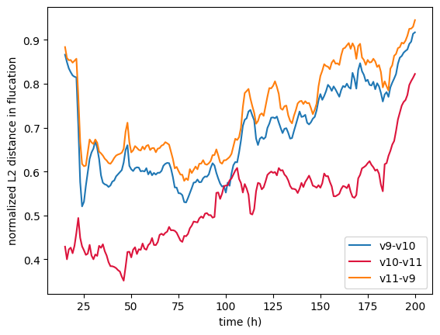
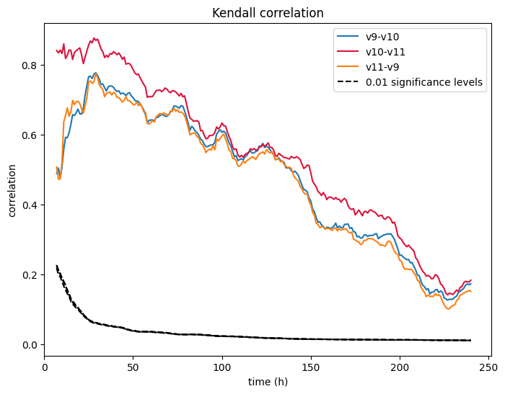
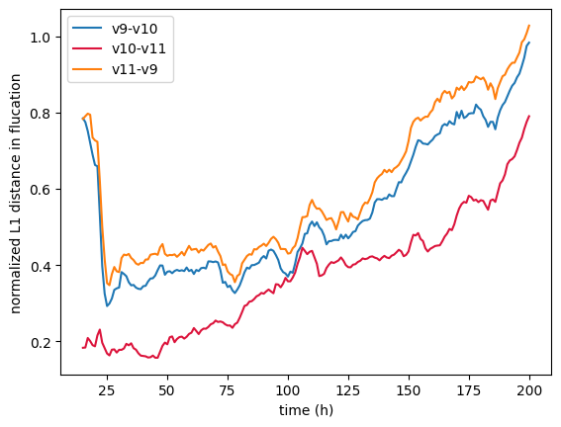
Consistent result in inter-model similarity is obtained
The normalized Lp distance is the largest between version 9 and 11, and smallest between version 10 and 11. Version 10 and 11 is the most correlated pair.
These align with what is observed in modelling sand-dust storm, and therefore, suggest that the phenomenon is not an artifact of release locations, release duration, released species, and weather conditions.

Slide 22
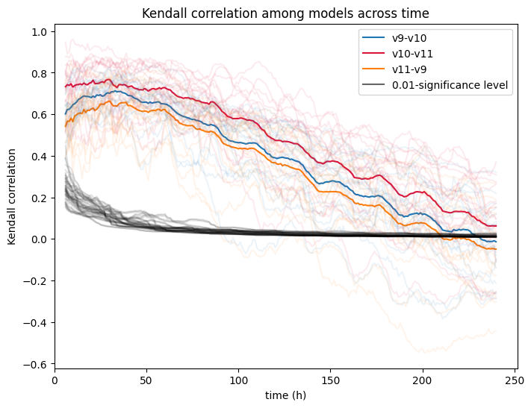
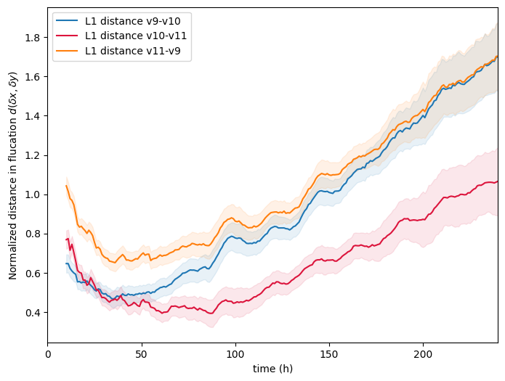
(Extra slide.) Measurement repeated for 18 nuclear power plants around the globe
Models maintain a significant correlation for around 8-9 days on average

Slide 23
Conclusion
(Inter-model similarity.) Flexpart 9 is the odd-one-out. Difference between version 10 and 11 is the least while that between version 9 and 11 is the greatest.
(Predictive power.) Both Flexpart 10 and 11 better predict arrival times than Flexpart 9, but between themselves, they share comparable performances.
All three models show positive spatial-correlation with observation, but the level of correlation is similar. Flexpart 9 has near zero median temporal-correlation with observation.
All three versions are unable to predict peak PM10 values under heuristic tuning of the release mass. A more robust test is needed removing the assumption of linearity, or by fine-tuning the initial condition.
(Realistic diffusion.) Well-mixed criterion is better reproduced by Flexpart version 10 than by 9, suggesting more realistic convection and diffusion.

Slide 24
Future directions
(Method assumption.) An alternative choice of proxy for sand-dust air concentration is the PM10/PM2.5 ratio, since sand-dust is estimated to have a mean diameter of 6µm. A bad proxy may be the reason for the bad alignment in absolute values, and removing the PM2.5 component could potentially help reduce the noise in the current benchmark.
More accurate initial condition may improve model performance. Varies the distribution within the current release box and see the variability in 1. RMSE of arrival times; 2. FAC2 of peak values; 3. time or space-averaged correlations with real data. High variability suggest a high sensitivity of the performance metric on the initial condition, and that a further fine-tuning of it is worth the computation time.
Reanalysis data should be used to test well-mixed criterion
(Model assumption.) Test if the use of skewed turbulence schemes and adaptive time-stepping improve or worsen model performance in terms of the abovementioned metrics.

Slide 25
Appendix

Slide 26
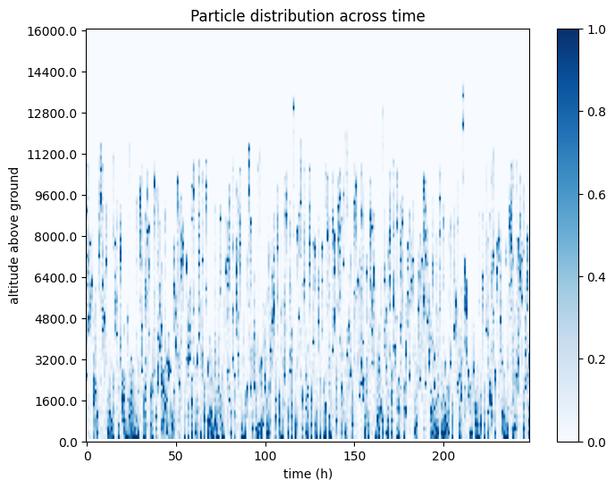
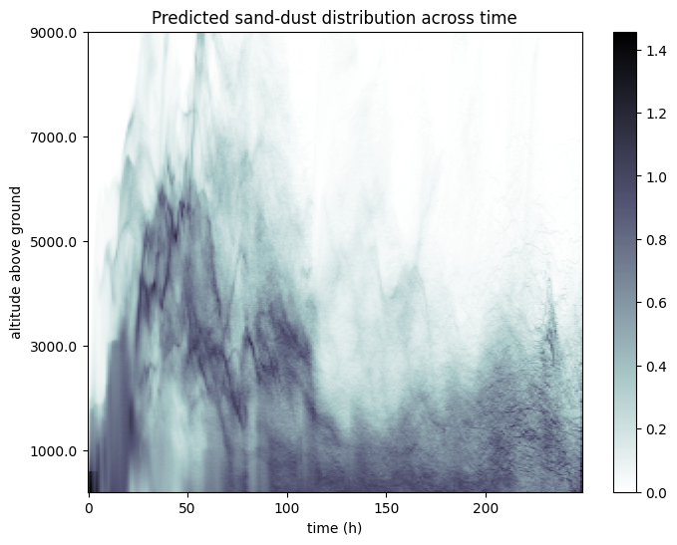
Vertical profile across time
Notes:
OUTHEIGHT control the vertical resolution. The concentration output at each heigh layer correspond to the average concentration from its parameter OUTHEIGHT to the one below.

